Slide 1
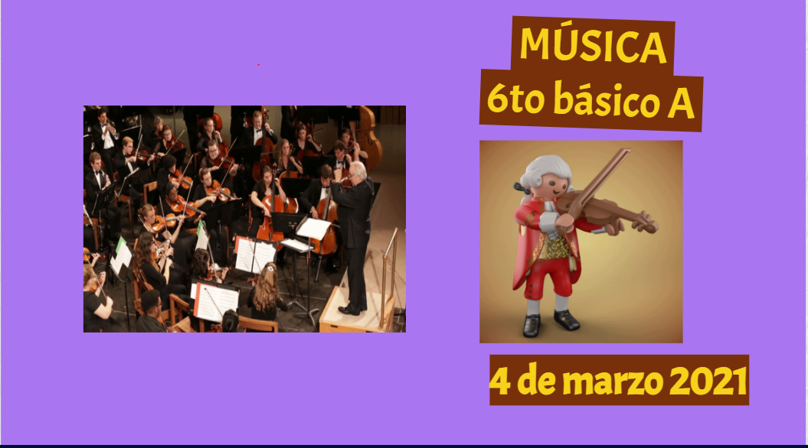

Slide 3
Link Genialy
https://view.genial.ly/5fa536282463d50d4aa86d70/presentation-6-basico-a-06-11

