Slide 1
English class! March sixteenth

Slide 2
Route
1.
Objective
2.
Review of vocabulary
3.
Quizizz activity
4.
Quizizz activity 2
5.
Questions

Slide 3
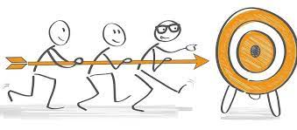
1. Objective:
To practice last year vocabulary:
Ordinal numbers, physical and personality descriptions and questions.

Slide 4
2.
Review of vocabulary
https://www.baamboozle.com/game/392448

Slide 5
3.
Quizizz activity
https://quizizz.com/join?gc=13392834

Slide 6
4.
Quizizz activity
https://quizizz.com/join?gc=27130818

Slide 7
5. Questions
On your notebooks write and answer these questions:
How old are you?
Who is your best friend?
How old is your best friend?
Where do you live?
When is your birthday?
What does your best friend look like?
What is your best friend like?

