Slide 1
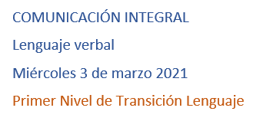

Slide 2
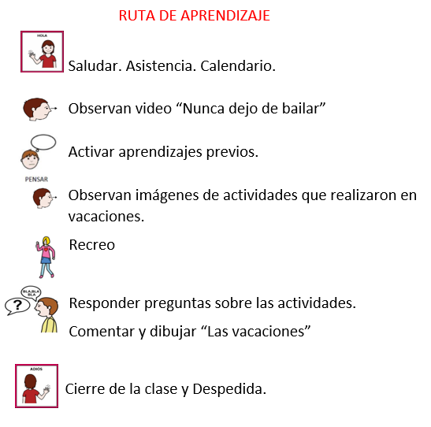

Slide 3
https://www.youtube.com/watch?v=cis_-XswQgU

Slide 4
