Slide 1
English class April first

Slide 2
Route
1. Objective
2. Vocabulary practice
3.Task a): Create a padlet
4. Task b) Share your link of your padlet

Slide 3
1. Objective:
To practice vocabulary and create a padlet for your english tasks following instructions.

Slide 4
2. Free time activities vocabulary practice https://kahoot.it/challenge/05793513?challenge-id=edadaaa6-0737-4765-8f8e-c081ddc7e473_1617065583434 Game PIN: 05793513

Slide 5
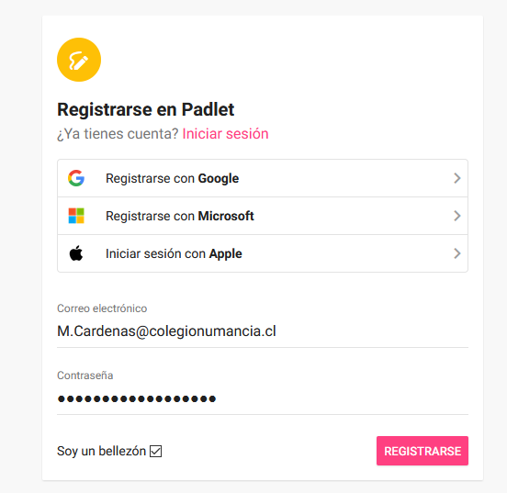
3. Task A) Create a Padlet
1. Go to
https://es.padlet.com/auth/signup
2. Use your institutional e-mail and
Use the same password.
3. Click on “registrarse”

Slide 6
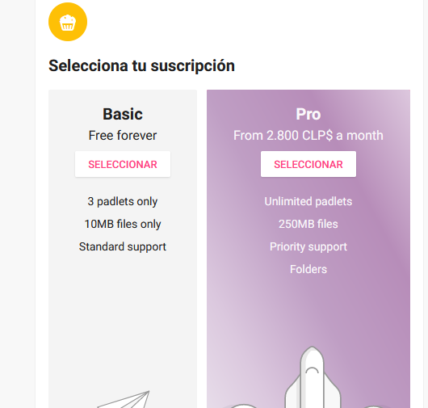
3. Task A) Create a Padlet
4. Choose “basic” subscription:

Slide 7
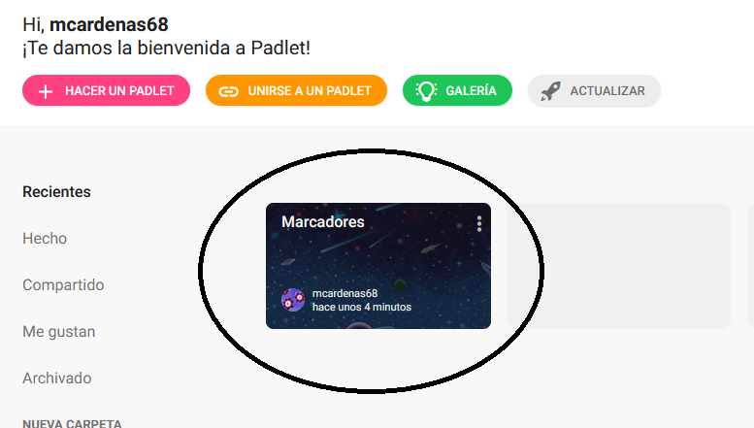
3. Task A) Create a Padlet
5. Click/touch on “marcadores”

Slide 8
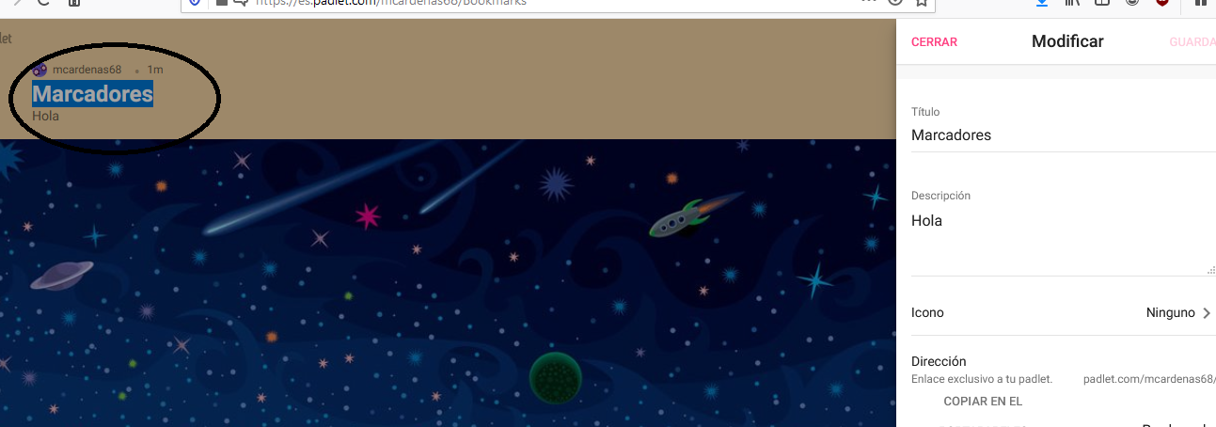
3. Task A) Create a Padlet
5. Click/touch on “marcadores”

Slide 9
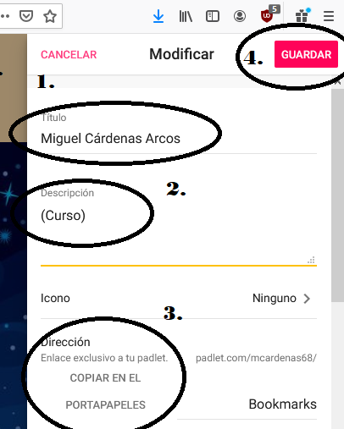
3. Task A) Create a Padlet
Write your name
Write your grade
Click on
“copiar en el portapapeles”
4. Click on guardar.

Slide 10
4. Task b) Share your link
Go to
https://padlet.com/mcardenas68/septimob

Slide 11
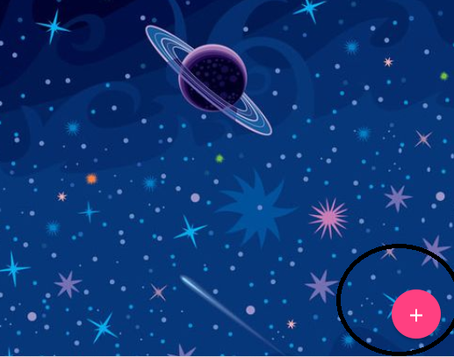
4. Task b) Share your link
2. Add a note (click on the circle)

Slide 12
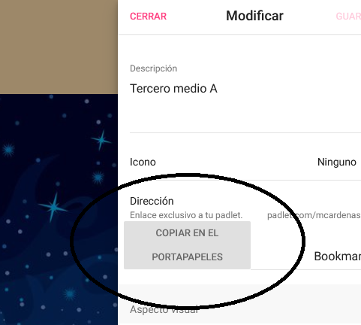
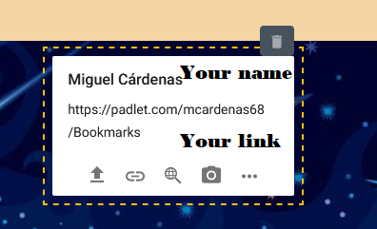
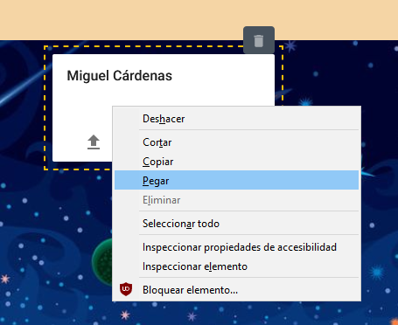
4. Task b) Share your link
3.. Write your name and paste the
Link of YOUR padlet

Slide 13
Well done!

