Slide 1
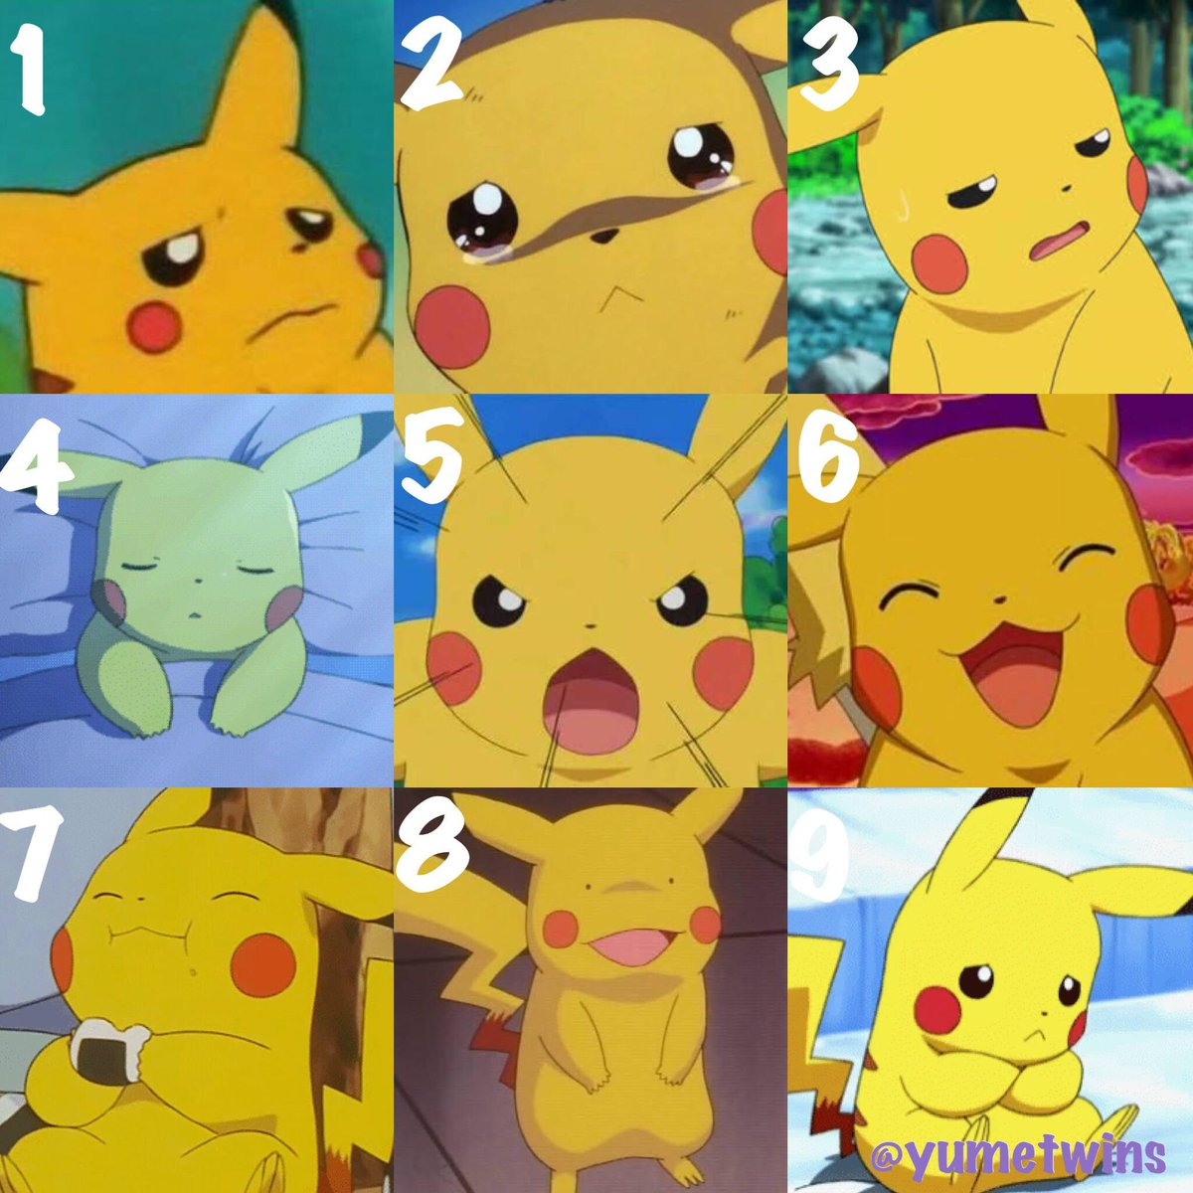
BEFORE WE START!
01
Answer orally or on the chat:
How are you?
02
03
04

Slide 2
UNIT 0: REVIEW English Class
Fifth Grade
14 – 04 – 2021

Slide 3
01.
Learning Outcome:
01
02
03
04
Reforzar contenidos previos (2020)

Slide 4
ACTIVATION: VOCABULARY REVIEW
01
02
1.
03
Con más calma, puedes volver a desarrollar la actividad de activación!
04
Complete the activity in the following link: https://es.educaplay.com/recursos-educativos/6293827-unit_2_vocabulary_dictation.html

Slide 5
2. VOCABULARY REVIEW
Completa los siguientes diálogos en tu cuaderno:
01
- How are you?
- __________
- Hello, my name is Mark!
- ________
02
03
- Thank you!
- ________
- How are you?
- _________
04
- How are you?
- _________
- Okay, bye!
- ________

Slide 6
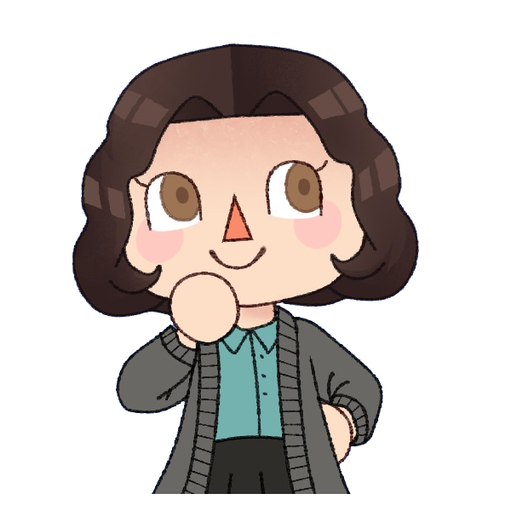
EXCELLENT JOB!
01
Do you have any questions?
f.olivares@colegionumancia.cl
02
03
04
Please keep this slide for attribution

