Slide 16
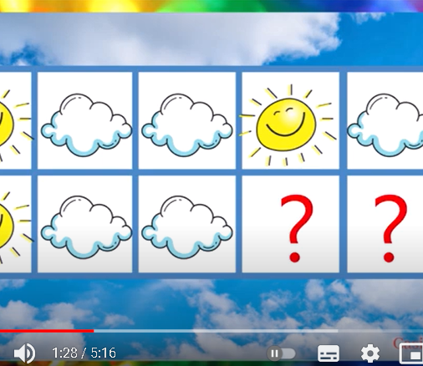
https://www.youtube.com/watch?v=nXvuji6-mJc&ab_channel=CasitaPreescolar

Slide 28
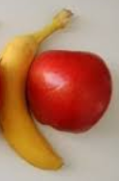

Slide 31
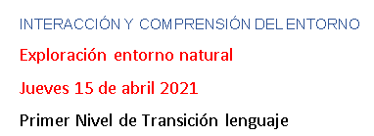

Slide 37
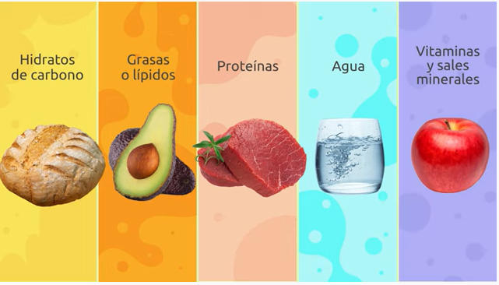

Slide 38
