Slide 1
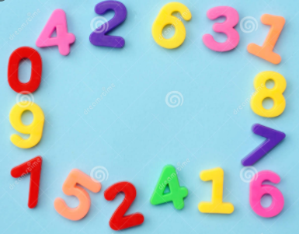

Slide 2
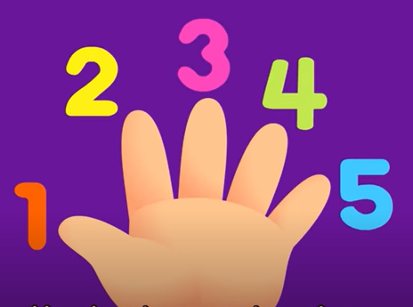

Slide 11
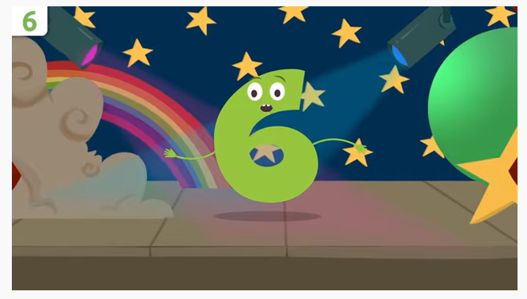
https://www.youtube.com/watch?v=aApx1wOz-84

Slide 12
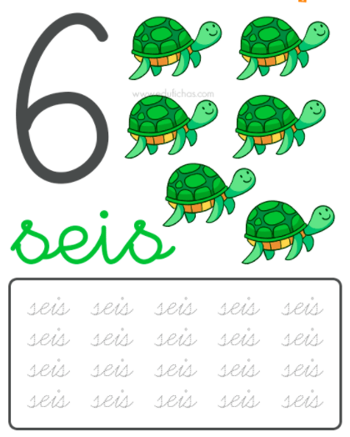

Slide 13
https://www.youtube.com/watch?v=qrNCH-7xyH4

Slide 16
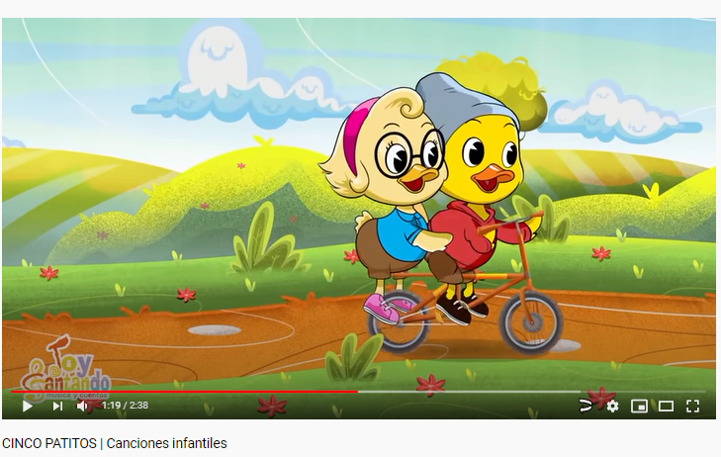
https://www.youtube.com/watch?v=Vqq3BwgsI0U&ab_channel=toycantando

Slide 27
