Slide 1
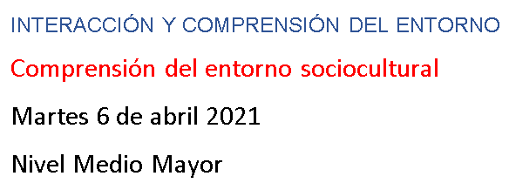

Slide 2
https://www.youtube.com/watch?v=7qvy_wXeCxM

Slide 13
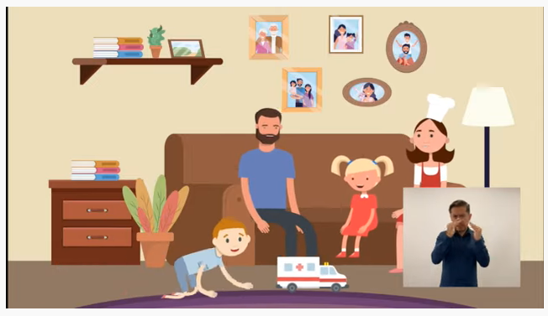
https://www.youtube.com/watch?v=vYX4FOFXdiI

Slide 14
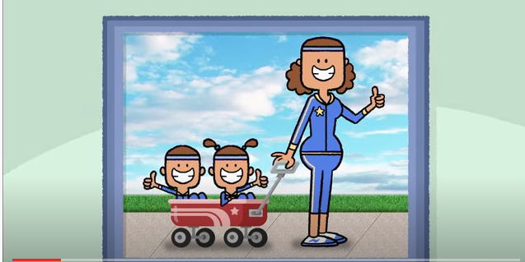
https://www.youtube.com/watch?v=WK30vsnp2WA

Slide 17
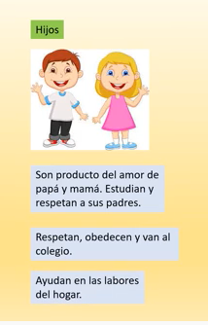

Slide 22
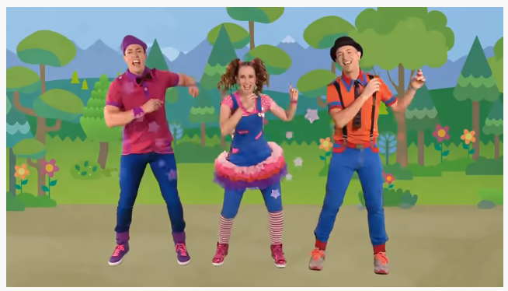
https://www.youtube.com/watch?v=Uhjggis3fkw

Slide 23
https://www.youtube.com/watch?v=zfRG8I6wp8Y

Slide 24
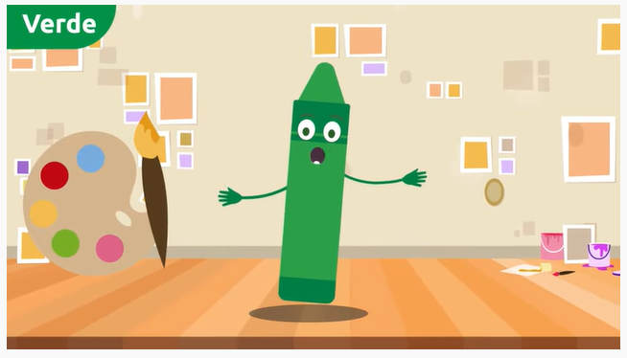

Slide 27
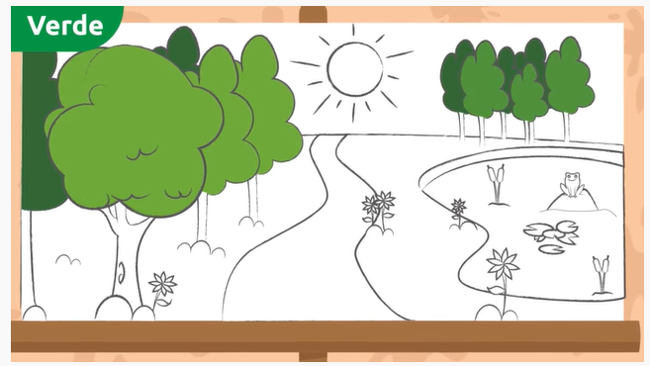

Slide 30
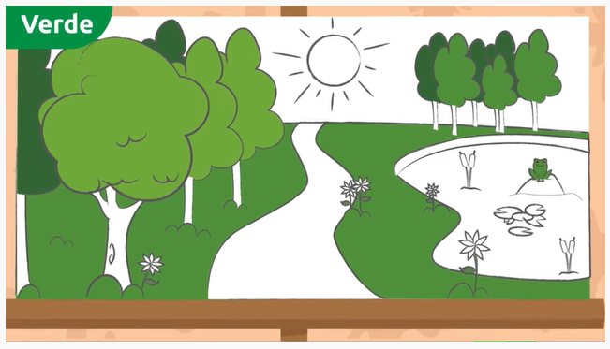

Slide 32
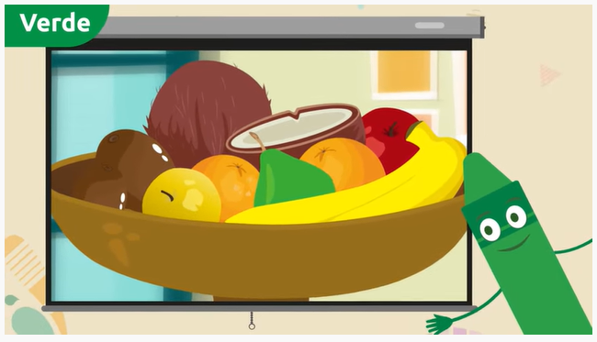

Slide 33
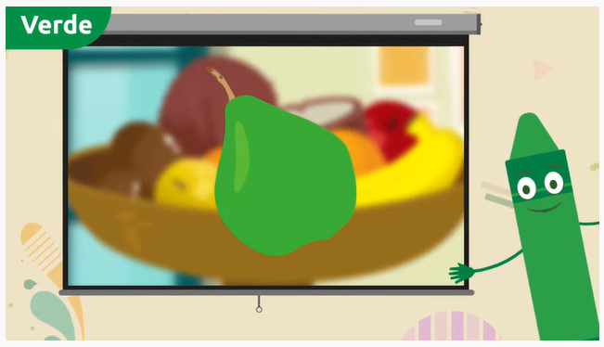

Slide 34
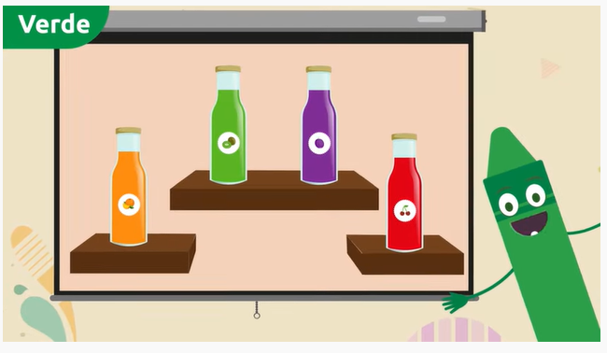

Slide 35
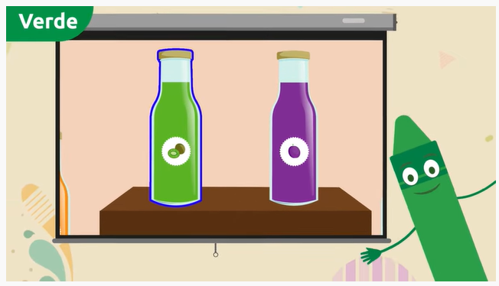

Slide 36
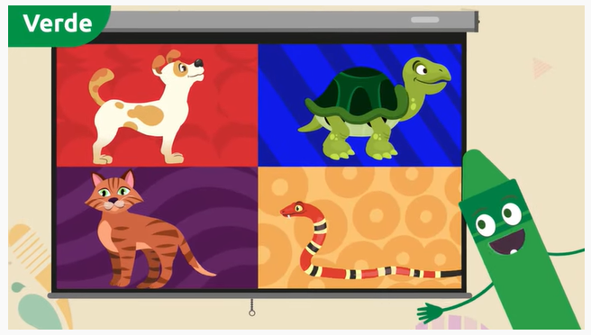

Slide 37
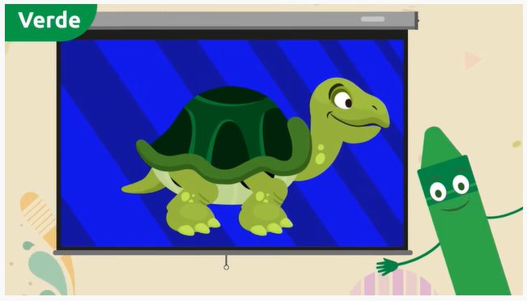

Slide 39
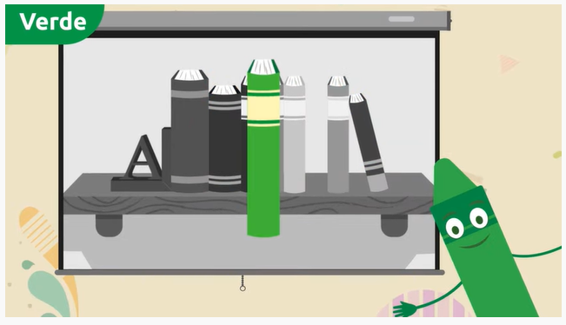

Slide 42
