Slide 4
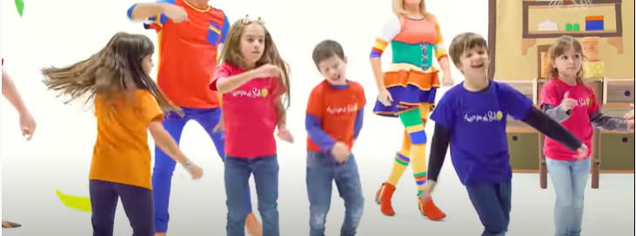
https://www.youtube.com/watch?v=1I3aMmVjMaY&ab_channel=TiempodeSol

Slide 11
https://www.youtube.com/watch?v=OEQRfQ6l7BA&ab_channel=ElPayasoPlimPlim

Slide 13
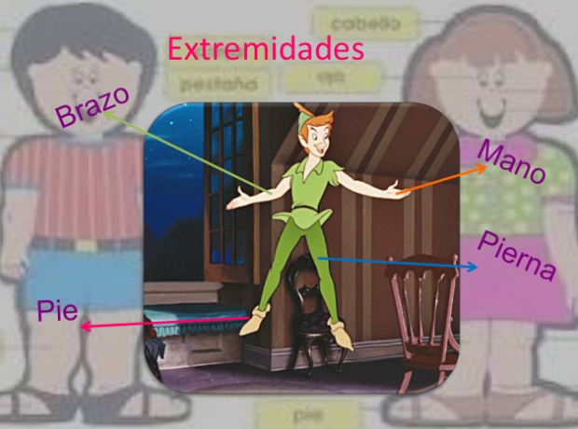

Slide 15
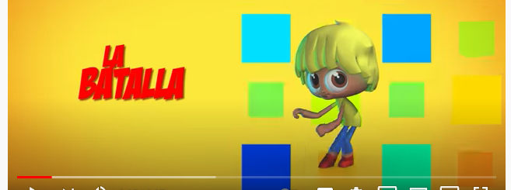
https://www.youtube.com/watch?v=TezsPt10nhA&ab_channel=ElReinoInfantil

Slide 37
https://www.youtube.com/watch?v=Cw5BWA8eM7I&t=102s

