Slide 7
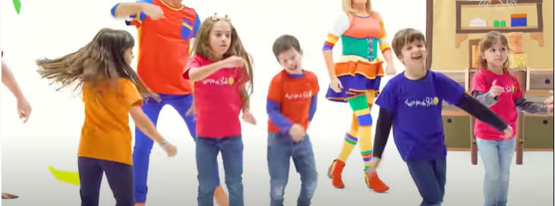
https://www.youtube.com/watch?v=1I3aMmVjMaY&ab_channel=TiempodeSol

Slide 13
https://www.youtube.com/watch?v=OEQRfQ6l7BA&ab_channel=ElPayasoPlimPlim

Slide 15
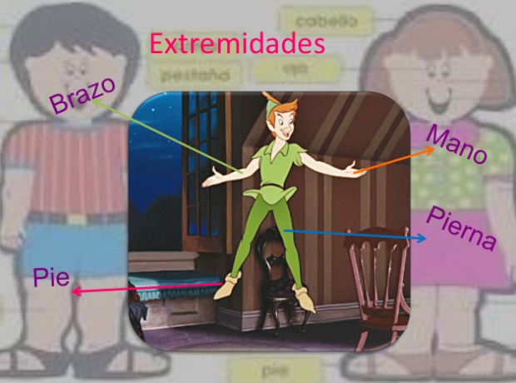

Slide 23
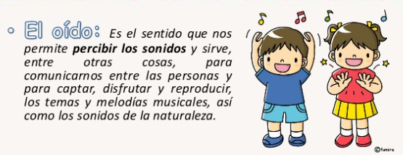

Slide 24
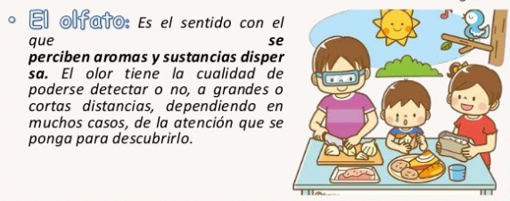

Slide 26
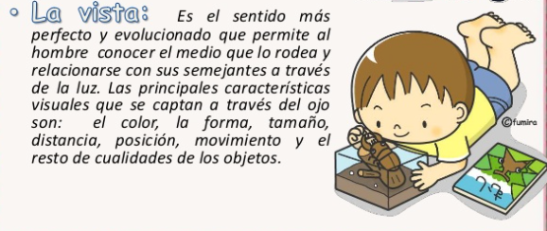

Slide 28
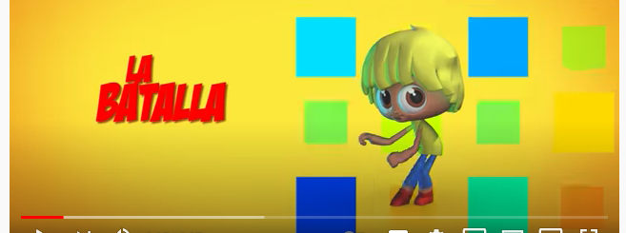
https://www.youtube.com/watch?v=TezsPt10nhA&ab_channel=ElReinoInfantil

